Slide 2
Introduction
Web Development with JavaScript and DOM
TWJK14 Spring 2017
Peter Larsson-Green

Slide 3
Ping Pong
Ping Pong event:
Web Development with JavaScript and DOM - TWJK14 - S17
Ping Pong password:
TWJK14S1717
Read study-guide.pdf on Ping Pong, and the documents it links to.

Slide 4
charsets & encodings
"Computers only understand numbers."
Each character is mapped to a number.
char string[] = "Hello";
A string in C.
Which character is mapped to which number?
Is described by the used character encoding.
Which characters can we use?
Is described by the used charset.
De facto standard encoding: ASCII

Slide 5
ASCII
American Standard Code for Information Interchange
Each character represented by 7 bits.
2⁷ = 128.
http://www.ascii-code.com
Does not contain å, ä, ö, Å, Ä or Ö ☹
Computers usually work with 8 bits.
Encodings extending ASCII has been created.
128 additional characters!
Number | Character
0 | NUL
... | ...
65 | A
66 | B
... | ...
97 | a
98 | b
... | ...
127 | DEL

Slide 6
Extended ASCII
There exists many of them!
Number | Character
0 | NUL
... | ...
127 | DEL
128 | PAD
... | …
196 | Ä
197 | Å
... | ...
214 | Ö
... | ...
255 | ÿ
Number | Character
0 | NUL
... | ...
127 | DEL
128 | €
... | …
196 | Ä
197 | Å
... | ...
214 | Ö
... | ...
255 | ÿ
ISO 8859-1 / ISO Latin-1
Windows-1252 / ANSI

Slide 7
Unicode
The solution to all encoding problems!
A charset that can store ~1.000.000 characters.
Numbers 0-127 mapped the same way as in ASCII.
It is backward compatible with ASCII.
Exists different encodings:
UTF-32: each character represented by 32 bits.
But most common characters (a-z, A-Z) only requires 7 bits!
UTF-8: each character represented by 8, 16, 24 or 32 bits.
ASCII characters represented by 8 bits.

Slide 8
web browser encodings
Which character encoding do web browsers use?
Written in the webpage by the webpage author.
If the character encoding is not written in the webpage?
Up to the web browser to decide.
In practice: UTF-8

Slide 9
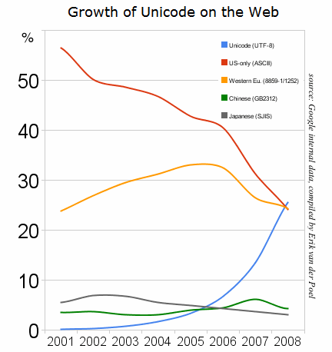
Unicode on the web
http://pinyin.info/news/2015/utf-8-unicode-vs-other-encodings-over-time/

Slide 10
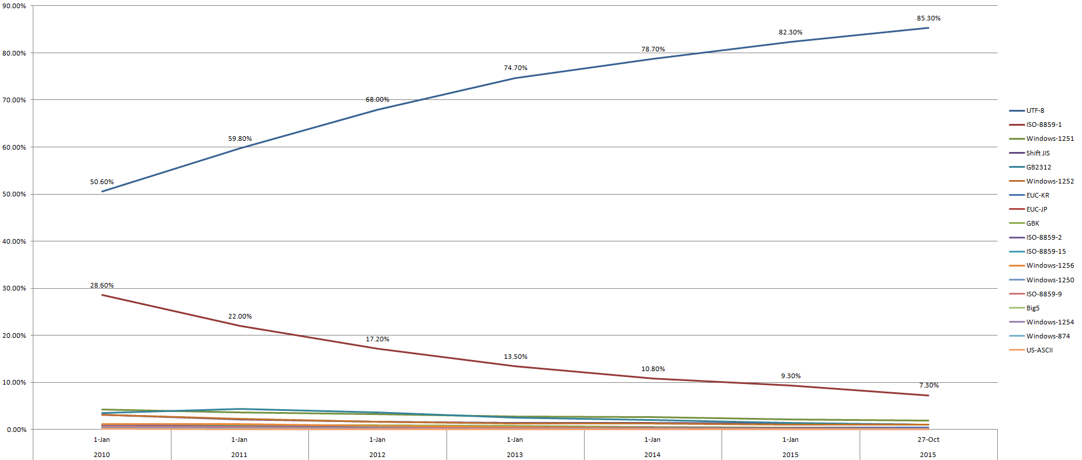
Unicode on the web
http://pinyin.info/news/2015/utf-8-unicode-vs-other-encodings-over-time/

Slide 11
The Internet
Internet
Your computer
Other computer
IP
IP
121.47.3.41
11.87.2.210
A network that has grown bigger and bigger since 1950's.
http://www.submarinecablemap.com
The Internet Protocol is used for communications.
Each connected computer is assigned a unique IP address (32 bit).
Find your computer's IP address: http://www.whatsmyip.org
Find your computer's IP address: Get-NetIPAddress in Windows PowerShell
A package contains a small message, delivery not guaranteed.

Slide 12
The Internet
Internet
Your computer
Other computer
IP
IP
121.47.3.41
11.87.2.210
Services
E-mail (SMTP, Simple Mail Transfer Protocol).
File sharing (FTP, File Transfer Protocol).
DNS, Domain Name System (UDP or TCP).
World Wide Web (HTTP, HyperText Transfer Protocol).
And more!
The port indicates the protocol.

Slide 13

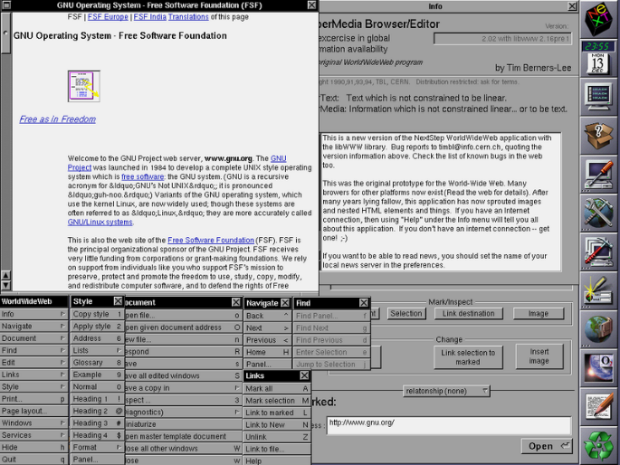
The Web
Created by Tim Berners-Lee at CERN 1989.
http://home.cern/topics/birth-web
The first web page:
http://info.cern.ch/hypertext/WWW/TheProject.html
The first web browser:
WorldWideWeb
"Maintained" by W3, World Wide Web Consortium.
https://www.w3.org/Consortium

Slide 14
The Web
page-a.html
page-b.html
Client
Your computer
Other computer
HTTP
121.47.3.41
svt.se
Server
HTTP: HyperText Transfer Protocol
HTML: HyperText Markup Language
HyperText = a hyperlink to another web page (forms a web!).
page-c.html
page-e.html
page-a.html
page-b.html
page-d.html

Slide 15
HTTP
page-a.html
page-b.html
Client
Your computer
Other computer
HTTP
121.47.3.41
svt.se
Server
The client sends an HTTP requests to the server.
Give me resource X!
The server sends back an HTTP response.
Here's resource X!
HTTP specification: https://tools.ietf.org/html/rfc2616

Slide 16
HTTP Requests
Uniform Resource Identifier
HTTP version
Method
Server
GET /path/to/the-page.html HTTP/1.1
Host: www.the-website.com
Accept: text/html,application/xhtml+xml;q=0.9,*/*;q=0.8
Accept-Language: en-US;q=0.8,en;q=0.6,sv
optional-body
Response desired data format
Response desired language
Specification: https://tools.ietf.org/html/rfc2616#section-5

Slide 17
HTTP Response
HTTP version
Status code
Reason phrase
Data format
HTTP/1.1 200 OK
Content-Type: text/html
Content-Length: 18
<html>
...
</html>
Number of bytes in body
Body
Specification: https://tools.ietf.org/html/rfc2616#section-6

Slide 18
HTTP methods
GET /path/to/the-page.html HTTP/1.1
Host: www.the-website.com
Accept: text/html,application/xhtml+xml;q=0.9,*/*;q=0.8
Accept-Language: en-US;0.8,en;q=0.6,sv
Method
GET
Should not result in changes on the server.
POST
May result in changes on the server.
Data can be passed in the body of the request.
DELETE, HEAD, PUT, PATCH, …
Specification: https://tools.ietf.org/html/rfc2616#section-9

Slide 19
HTTP Status codes
Status code
HTTP/1.1 200 OK
Content-Type: text/html;
Content-Length: 18
<html>
...
</html>
List of status codes:
http://www.restapitutorial.com/httpstatuscodes.html
Specification: https://tools.ietf.org/html/rfc2616#section-6.1.1

Slide 20
A web page
Clients primarily requests HTML files.
<!DOCTYPE html>
<html>
<head>
<title>Hello</title>
</head>
<body>
<h1>Hi!</h1>
<p>Nice to meet you!</p>
</body>
</html>
Hi!
Nice to meet you!
HTML page rendered by web browsers.

Slide 21
A web page
Clients primarily requests HTML files.
But an HTML file usually depends on other files.
<!DOCTYPE html>
<html>
...
<body>
<h1>An image</h1>
<img src="smiley.jpeg">
</body>
</html>
A new GET request!
An image
☺
HTML page rendered by web browsers.

Slide 22
A web page
Clients primarily requests HTML files.
But an HTML file usually depends on other files.
A web page usually consists of:
Data.
Ordinary text.
HTML, HyperText Markup Language.
Marks the data.
CSS, Cascading Style Sheet.
Tells the web browser how to render the data.
JS, JavaScript.
Interacts with the web page.

Slide 23
User agents (the clients)
Web browsers.
Chrome, Firefox, Internet Explorer, Safari, Opera, Edge, ...
Web spiders.
Google, Bing, Yahoo, ...
page-c.html
page-e.html
page-a.html
page-b.html
page-d.html

Slide 24
HTML, CSS & JS not only for the web
Games:
http://www.schillmania.com/survivor
Extensions/Add-ons for browsers:
https://developer.chrome.com/extensions/getstarted
Apps for smartphones/tablets:
https://cordova.apache.org
Programs for computers:
https://atom.io
JavaScript on the server:
https://nodejs.org

Slide 25
web pages
Benefits
Easy to get started.
Fast development.
OS independent.
Drawback
Runs slowly.
Are limited.
Standards not always followed by web browsers.

Slide 26
Recommended reading
The Absolute Minimum Every Software Developer Absolutely, Positively Must Know About Unicode and Character Sets (No Excuses!) written by Joel Spolsky:
https://www.joelonsoftware.com/2003/10/08/the-absolute-minimum-every-software-developer-absolutely-positively-must-know-about-unicode-and-character-sets-no-excuses/
HTTP Made Really Easy, written by James Marshall:
https://www.jmarshall.com/easy/http
HTTP specification:
https://tools.ietf.org/html/rfc2616
The birth of the web
http://home.cern/topics/birth-web

